Slide 1
FIT1045 Introduction to Algorithms and Programming Lecture 7 Invariants
COMMONWEALTH OF AUSTRALIA
Copyright Regulations 1969
WARNING
This material has been reproduced and communicated to you by or on behalf of Monash University pursuant to Part VB of the Copyright Act 1968 (the Act).The material in this communication may be subject to copyright under the Act.Any further reproduction or communication of this material by you may be the subject of copyright protection under the Act.
Do not remove this notice.

Slide 2
How many subsets of {a, b, c, d, e} are there?
16
31
32
None of the above

Slide 3
Overview
Milk and Water
Examples
Cutting the Chocolate Block
Mutilated Chessboard
14-15 puzzle

Slide 4
Milk and Water
Consider two glasses. One of milk and another with the same amount of water.
Take a spoonful of milk and mix it into the glass of water.
Now, take a spoonful of the mixture of milk and water and put it back into the glass of milk.
Notes:
Describe the invariant for this problem, i.e, the amount of liquid in the two glasses has not changed..

Slide 5
Is there:
More milk in the water than water in the milk?
More water in the milk than milk in the water?
The same amount of milk in the water as water in the milk?
Cannot tell.

Slide 6
Invariant
An invariant is a property that does not change.

Slide 7
Milk and Water
Each glass starts with x litres of liquid
At conclusion of the process …
The Water glass has r litres of milk and x-r litres of water
Invariant: x litres of milk and x litres of water
The Milk glass has x-r litres of water and r litres of milk
The same amount of milk in the water as water in the milk

Slide 8
Prim’s algorithm
Choose a vertex in the Graph
Add the edge to the Tree.
Put the vertex in the Tree
Is there a vertex not in the Tree?
Yes
Choose an edge between the Tree and this vertex
No
Return the tree
Notes:
Illustrate how this algorithm works.

Slide 9
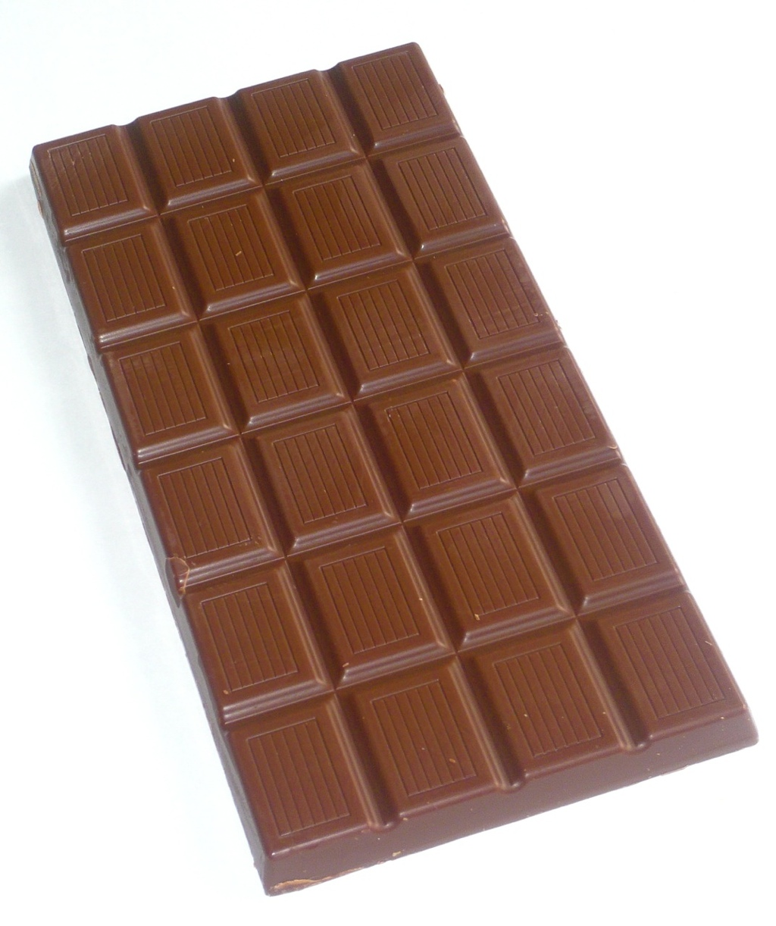
Cutting the Chocolate Block
A chocolate block is divided into squares by horizontal and vertical grooves. The object is to cut the chocolate block into individual squares.
Assume each cut is made on a single piece along a groove. How many cuts are needed?
© 2006-2009 Chocablog.com (http://www.chocablog.com/reviews/ms-organic-fairtrade-milk-chocolate-with-rose/)
Notes:
9

Slide 10
How many cuts does it take to divide the following block into squares?
8
3
24
25
None of the above

Slide 11
How many pieces?

Slide 12
How many pieces?
1 cut
2 pieces

Slide 13
How many pieces?
2 cuts
3 pieces
Notes:
Describe the invariant for this problem, i.e., the number of pieces are one more than the number of cuts (no matter how it is cut).

Slide 14

Importance of sorting
http://www.tumblr.com (my-life-in-books)

Slide 15
Sorting
The basic building block for many algorithms.
Finding Convex Hulls in 2D.
Hidden surface elimination
Many of the interesting ideas in the design of algorithms appear in different sorting methods.
Divide and Conquer
Brute Force
Heaps
Computers spend a lot of time sorting.
It is one of the most studied areas in computer science.
Notes:
Explain the importance of sorting in computer science.

Slide 16
Sorting Lists
Input:
A list (not necessarily sorted) of ‘orderable’ element types
For example, in Python:
the_list = [5,1.5,3,-4.0] is fine
the_list = [1,'hj',0,'j'] is not
Unless you define your own comparison function
Output:
A list with the same elements as the input list BUT sorted in increasing or decreasing order
Notes:
Answer: You use the name attribute to implement the comparable interface via the name attribute.
(Don’t need to mention comparable interface in class).
Just implement compareTo via CompareTo of Strings.Demonstrate this in BlueJ.

Slide 17
Insertion Sort
Algorithm InsertionSort(L)
// Sorts a list using insertion sort
// Input: A list of orderable items
// Output: A list sorted in increasing order
n ⟵ length(L)
k ⟵ 1
while k < n {
Put L[k] in the correct position in L
k ⟵ k + 1
}
5
2
4
6
8
5
k

Slide 18
Insertion Sort: Code
‘Sort the list using insertion sort’
n = len(aList)
for k in range(1,n):
# Invariant: items in aList[0 … k-1] are sorted
temp = aList[k]
i = k – 1
while i >= 0 and aList[i] > temp:
‘Shuffle items along’
aList[i+1] = aList[i]
i -= 1
aList[i+1] = temp
# items in aList[0 … k-1] are sorted and k is n; i.e., items in aList[0 … n-1] are sorted
temp
5
2
4
6
8
5
k

Slide 19
Mutilated Grid
Notes:
Ask whether they can cover the mutilated grid with tiles like them one on the right.

Slide 20
We can tile the mutilated grid with 2 x 1 tiles?
True
False
30

Slide 21
Mutilated Chessboard
Notes:
Point out each tile covers a black square and a white square. Count the number of white and black squares in the mutilated chessboard. This shows that it is not possible.

Slide 22
Cover Non-star Squares
Notes:
Note one star is on a black and one on a white square. Ask whether you can cover all the non-star squares on the chessboard with tiles like the one on the right. Get them to think about strategies for solving problems, e.g. simpler problems and smaller chessboards.

Slide 23
We can cover the non-star squares with 2x1 tiles?
True
False
30

Slide 24
One Dimensional Problem
Notes:
Point out that when you have a 2 dimensional problem you might try a one dimensional problem first.

Slide 25
Circle Problem
Notes:
Ask them whether they can cover the non-star squares with tiles. Does it matter where the starts are?

Slide 26
Using the Circle

Slide 27
Using the Circle
Notes:
Show there is a circle hidden in the chessboard.

Slide 28
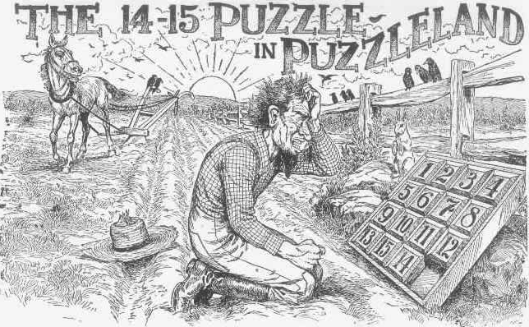
Sam Loyd, Cyclopedia of Puzzles ,Lamb Publishing Company, 1914
Notes:
Point out that this was a very popular puzzle in the later part of the 19th century and early part of the 20th century, and people apparently got distracted from their work trying to solve it.

Slide 29
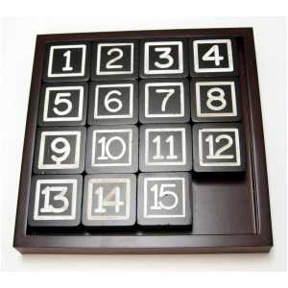
14-15 Puzzle
Consider the puzzle of sliding blocks below. Any block adjacent (left, right, above or below) the blank spot can be moved into the position of the blank spot. No diagonal moves are allowed. Can you find a series of moves so that all the blocks are in the order given, except that the 14 and 15 squares have exchanged places?
Image at: www.showmedistributors.com/items.php?id=games
Notes:
29

Slide 30
Example Moves
1
2
3
4
1
2
3
4
1
2
3
4
5
6
7
8
5
6
7
8
5
6
7
8
9
10
11
12
9
10
11
12
9
10
12
13
14
15
13
14
15
13
14
11
15
1
2
3
4
1
2
3
4
1
2
3
4
5
6
7
8
5
6
7
8
5
6
7
8
9
10
12
9
14
10
12
9
14
10
12
13
14
11
15
13
11
15
13
11
15
Notes:
Explain what happens when you move squares.

Slide 31
Interchanges
1
2
3
4
1
2
3
4
5
6
7
8
5
6
7
8
9
10
11
12
9
10
11
12
13
14
15
16
13
14
16
15
1
2
3
4
5
6
7
8
9
10
11
12
13
14
15
16
1
2
3
4
5
6
7
8
9
10
11
12
13
14
16
15
Notes:
Explain what happens when you move squares.

Slide 32
Interchanges
1
2
3
4
1
2
3
4
5
6
7
8
5
6
7
8
9
10
11
12
9
10
16
12
13
14
16
15
13
14
11
15
1
2
3
4
5
6
7
8
9
10
11
12
13
14
16
15
1
2
3
4
5
6
7
8
9
10
16
12
13
14
11
15
Notes:
Explain what happens when you move squares.

Slide 33
Moves and Interchanges
Some Invariants
Moving a tile horizontally does not change the total number of inversions
where an inversion is when a smaller value appears “after” a larger value (e.g., 15,14)
Moving a tile vertically changes the total number of inversions by an odd number
For the blank square to return to the starting position requires an even number of moves.
1
2
3
4
5
6
7
8
9
10
11
12
13
15
14
Notes:
Explain these invariants.

Slide 34
What have we learnt?
Some things never change…
which can be very useful.

Slide 35
Before Next Lecture
Read Section 9.1 in “Introduction to The Design and Analysis of Algorithms”.
Attempt the following problem…

Slide 36

A Torch Problem
Ando Hiroshige (http:www.hiroshige.org.uk)
Four people wish to cross a bridge at night. They need a torch to cross and they only have one torch between them. Also, since the bridge is narrow, they can only cross at most two at a time, and can only travel at the speed of the slowest. The four people can cross in 1 minute, 2 minutes, 5 minutes and 10 minutes, respectively. Find a way for them to cross in the minimum about of time.

